Slide 1
Be Smart…Be Safe
Acceptable Use of Internet & Technology and Netiquette for High School Students

Slide 2
School Rules and Internet Access
Lee County’s intent is to provide free and equal access to resources via the Internet.
All school rules for appropriate use of technology also apply to use of the Internet.
Users are expected to act in a considerate and responsible manner.
Be prepared to be held accountable for your actions. Exemplary behavior is expected from all users at all times.

Slide 3
Acceptable Use Policy
Copies of software or data may not be created or used on school equipment.
Computers should not be used to view, send, or display obscene, lewd, profane, vulgar, disrespectful, rude, threatening, or inflammatory language, messages, or pictures.
The posting of electronic chain letters or useless information is a violation of system policy.

Slide 4
Students or employees must not attempt to modify resources, utilities, or change restrictions on an account or attempt to breach any security system either with or without malicious intent.
Installation of software or downloading of files, games, programs, or other electronic media is prohibited unless it is being used for educational purposes.
Accessing any work, folders, or files which are not assigned to you, under your computer password is forbidden.

Slide 5
Consequences for Policy Violations
Loss of access
Additional disciplinary action in line with existing practice regarding inappropriate language or behavior
Legal action, when applicable
Remember
Internet access is a privilege, not a right.

Slide 6
Internet Safety Reminders
Students, faculty & staff are expected to access and use information that is appropriate for instructional & educational purposes.
Do not share your password or username with anyone.
Prior to use in the classroom, Internet sources will be screened for content.
Do not use the computer or Internet to reveal anyone’s personal address or phone number.

Slide 7
Independent Internet Access Requirements
Students and parent(s) complete and return the Acknowledgement and Contract contained in the student handbook each school year.
The completion of this contract allows independent access to the Internet by the student; and assures that both the student and parent(s) are aware of the Lee County guidelines regarding ethical use of the Internet and technology resources.

Slide 8
The Lee County Schools Guidelines
Regarding the Legal and Ethical Use of the Internet and Technology Resources for Students and for Employees is located in all student handbooks and on the Lee County Web Page under Technology.
www.lee.k12.al.us

Slide 9


Netiquette

Slide 10
Social Networking
Facebook
Twitter
My Space
Lesson 1

Slide 11
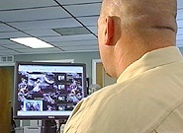
Who Is Looking At You Online?
Parents
Future Employers
Teachers
Law Enforcement
College Admission
Officers
Online Predators
Notes:
SAT scores are no longer the only consideration for getting into a good college. Before sending out acceptance letters, some college admission officers are checking out perspective student’s MySpace and other social networking sites pages. Police officers are looking for crime online and some employers are even firing people because of photos posted in profiles and other online activity.
11
9/24/2012

Slide 12

Check With Your Friends
Before posting pictures or information about your friends, check with them first. Always protect your privacy and theirs.
Check to see what your friends are posting about you. If anything they have posted about you makes you uncomfortable, ask them to remove it.
Notes:
12
Check with your friends first before posting information about them. Always protect you privacy and theirs.
Check to see what your friends are posting about you. If anything makes you uncomfortable, ask them to remove it.
9/24/2012

Slide 13

Check Comments Regularly!
If you have a profile or blog where other people make comments, check them often.
Do not respond to offensive or embarrassing comments. Delete them and block that person from making additional comments.
Notes:
13
If you have a blog where other people can make comments, check them often. Use the option to approve comments before they are posted to you page.
Do not respond to offensive messages. Delete them and block that person from making addition comments.
9/24/2012

Slide 14



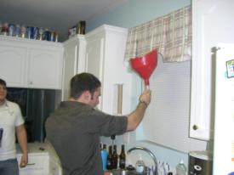


Think BEFORE Posting Pictures...
Consider if it is a picture you want everyone to see, including your parents, teachers, law enforcement and college admission officers. If not, then DON’T POST IT!
Remember that any picture you upload to the Web can be downloaded by anyone and be copied or posted online FOREVER.
14
Notes:
14
Imagine that you’ve been invited to a party. When you arrive, you realize it is a huge party with hundreds of people, but when you enter the room, the lights are off, the room is very dark, you can’t see the people and their voices are distorted, so you can’t even tell who is male or female. Would you walk around that party handing people your picture, or telling them your address or phone number?
Remember that any picture you upload to the Web can be downloaded by anyone and be copied or posted online forever.
9/24/2012

Slide 15
Do Not Give Out
Personal Information.
Never give out your personal identifying information or your families or friends, such as name, address, telephone number, and school name in any public areas or in email unless you are sure you know the person.
15
Notes:
15
Never give out personal information in any public areas.
9/24/2012

Slide 16
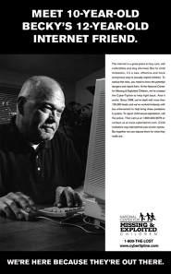
Never Meet With Someone in Real Life Who You First Met Online.
You don’t know for sure if people really are who they say they are. If you think it is appropriate to meet with someone, always discuss the meeting with your parents first, meet in a public place and never go alone.
It is a good idea to first have your parents speak with the parents of the person you want to meet.
Notes:
16
If someone wants to meet with you in real life, don’t be flattered, be suspicious. Any person worth having as a friend would be concerned about their own safety too.
9/24/2012

Slide 17
Beware when someone says…
“Let’s go private.”
“Where’s your computer in the house?”
“I know someone who can get you a modeling job.”
“Don’t tell your parents and/or friends about this, or I’ll post information/pictures about you on a website or blog.”
Notes:
17
Beware when someone says…
“Let’s go private” – predators want you to leave the public chatroom and create a private chat or move to instant-messaging or phone texting. This is a preferred communication method of predators.
“Where’s your computer in the house” – predators ask this to see if parents might be around.
“I know someone who can get you a modeling job” – predators think flattery will get them everywhere.
“Who’s your favorite band?” – questions like these tell the groomer more about you so they know what gifts to offer – e.g. concert tickets.
.
9/24/2012

Slide 18
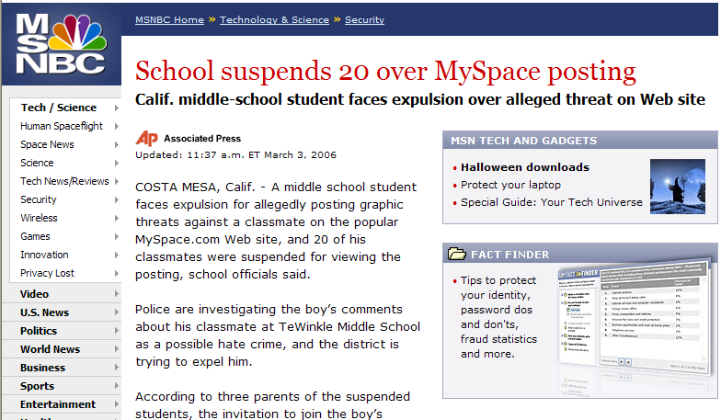
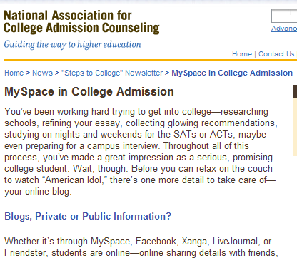
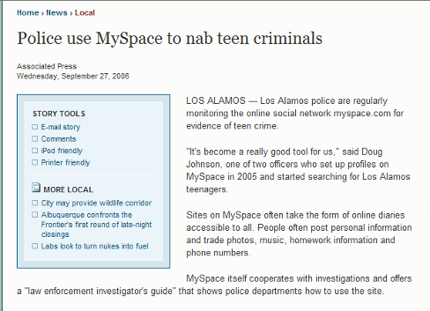

DO NOT SAY ANYTHING ONLINE THAT YOU WOULDN’T SAY OFFLINE.
Notes:
18
Do not say anything online that you wouldn’t say offline. Once you post something online, you can’t take it back.
9/24/2012

Slide 19
Cyber bullying
A person who uses the Internet to harass or intimidate someone else. An e-mail message with a phony from: address is a common way to reach someone without identifying the sender.
When cyber bullied you should immediately REPORT to a trusted adult (i.e., parent, teacher, counselor, church leader, other family members)
Lesson 2

Slide 20
Safety Tips Against
Cyber Bullies
Talk to a trusted adult if anything makes you feel scared, uncomfortable or confused.
Do not respond to messages that are rude or offensive.
Save messages that could be used by law enforcement as evidence.
20
Notes:
20
Talk to a trusted adult if anything makes you feel scared, uncomfortable or confused.
Do not respond to messages that are rude or offensive. Responding to this type of message may encourage the sender. If it continues, block the user on IM, email, chat or social networking sites.
Save message that could be used by law enforcement as evidence, especially if someone physically threatens you.
9/24/2012

Slide 21
Passwords and Personal Safety
Lesson 3

Slide 22
Personal Safety
Predators, Hackers and
Cyber bullies
Always Remember the 4 R’s!
RECOGNIZE techniques used by online predators to deceive their victims.
REFUSE requests for personal information.
RESPOND assertively if you are ever in an uncomfortable situation while online. Exit the program, log off or turn off the computer…
REPORT to a parent or other trusted adult any suspicious or dangerous contact that makes you uncomfortable.

Slide 23
Protect Your Passwords!
Use strong passwords and keep them confidential.
  Try to include upper & lower letters and numbers that would be hard for even your best friend to figure out.
Don’t give out your password, even to your best friend.
  You never know when someone will get mad at you and use your account to do bad things.
Notes:
23
Don’t use passwords that are easy for someone to guess, such as birth date or nickname. Use strong passwords with a combination of letters, numbers and symbols.
You should share your password with your parents, but no one else, not even your best friend.
Let’s watch a video that tells the true story of a girl who was the victim of cyberbullying after she shared her password with her best friend.
Play video.
9/24/2012

Slide 24
What is Phishing and
File Sharing?
Phishing – Term used when others can access your personal information (i.e., bank account, social security #, passwords)…so NEVER open an e-mail or click on a link where it asks you to update personal information or the site or address looks suspicious!
File Sharing – When you download others documents, music, images…never file share unless you are sure the file doesn’t have a virus OR the file wasn’t obtained illegally (without purchasing or asking permission to use).

Slide 25
Don’t Get D.U.P.E.D.!
D (Date) – Always check the date of a website you are visiting to make sure the information you are receiving is current.
U (URL) – If the URL (www. in the address bar) isn’t .gov or .edu, then you need to verify the information as accurate before using it. Always check the About Us/Contact Us and references to ensure reliability and validity.
P (Pop-ups) – If the site has a lot of pop up ads or the pop ads aren’t appropriate for the site (i.e., medical site should have medical pop up ads), then the site may not be accurate or trustworthy.
E (E-mail) – If you click on the e-mail link and it takes you to a suspicious URL, then you know the site is not trustworthy.
D (Design) – Check the design of the site to see if it looks professional, see if the links take you to a reliable source (if they even link to somewhere), see if the information is what is should be. Examples of non-reliable sites that look reliable are http://zapatopi.net/treeoctopus.html & http://dhmo.org

Slide 26
Safety Tips Review
Do not post personal information.
Respect copyright laws and check your sources.
Do not forward emails to “everyone” in your address book.
Secure your password – do not share it, even with your best friend.
Notes:
26
Don’t post personal information.
Copyright laws are for real and you must be careful when downloading and sharing music. Recently more than 18,000 file-sharers were sued by the recording industry association. Settlement costs can be as much as $3,000. A letter to one Ohio University student told her that she distributed 787 audio files, putting her total minimum potential liability at more than $590,000."
Don’t forward emails to “everyone” in your address book. If you receive a chain letter in an email, remember that chain letters are tricks and usually contain a virus or worm. Nothing bad will happen if you just delete the chain letter.
Use strong passwords and keep them confidential.
9/24/2012

Slide 27
Personal Safety Review
Predators, Hackers and
Cyber bullies
Always Remember the 4 R’s!
RECOGNIZE techniques used by online predators to deceive their victims.
REFUSE requests for personal information.
RESPOND assertively if you are ever in an uncomfortable situation while online. Exit the program, log off or turn off the computer…
REPORT to a parent or other trusted adult any suspicious or dangerous contact that makes you uncomfortable.

Slide 28
Bibliography
NYS Internet Crimes Against Children Task Force (2009). Retrieved from www.criminaljustice.state.ny.us
http://encyclopedia2.thefreedictionary.com/cyberbully

